Slide 1
Stylometrics and Genre Research in Imperial Chinese Studies
Intro and
Software Installation Instructions
vierthal@bc.edu

Slide 2
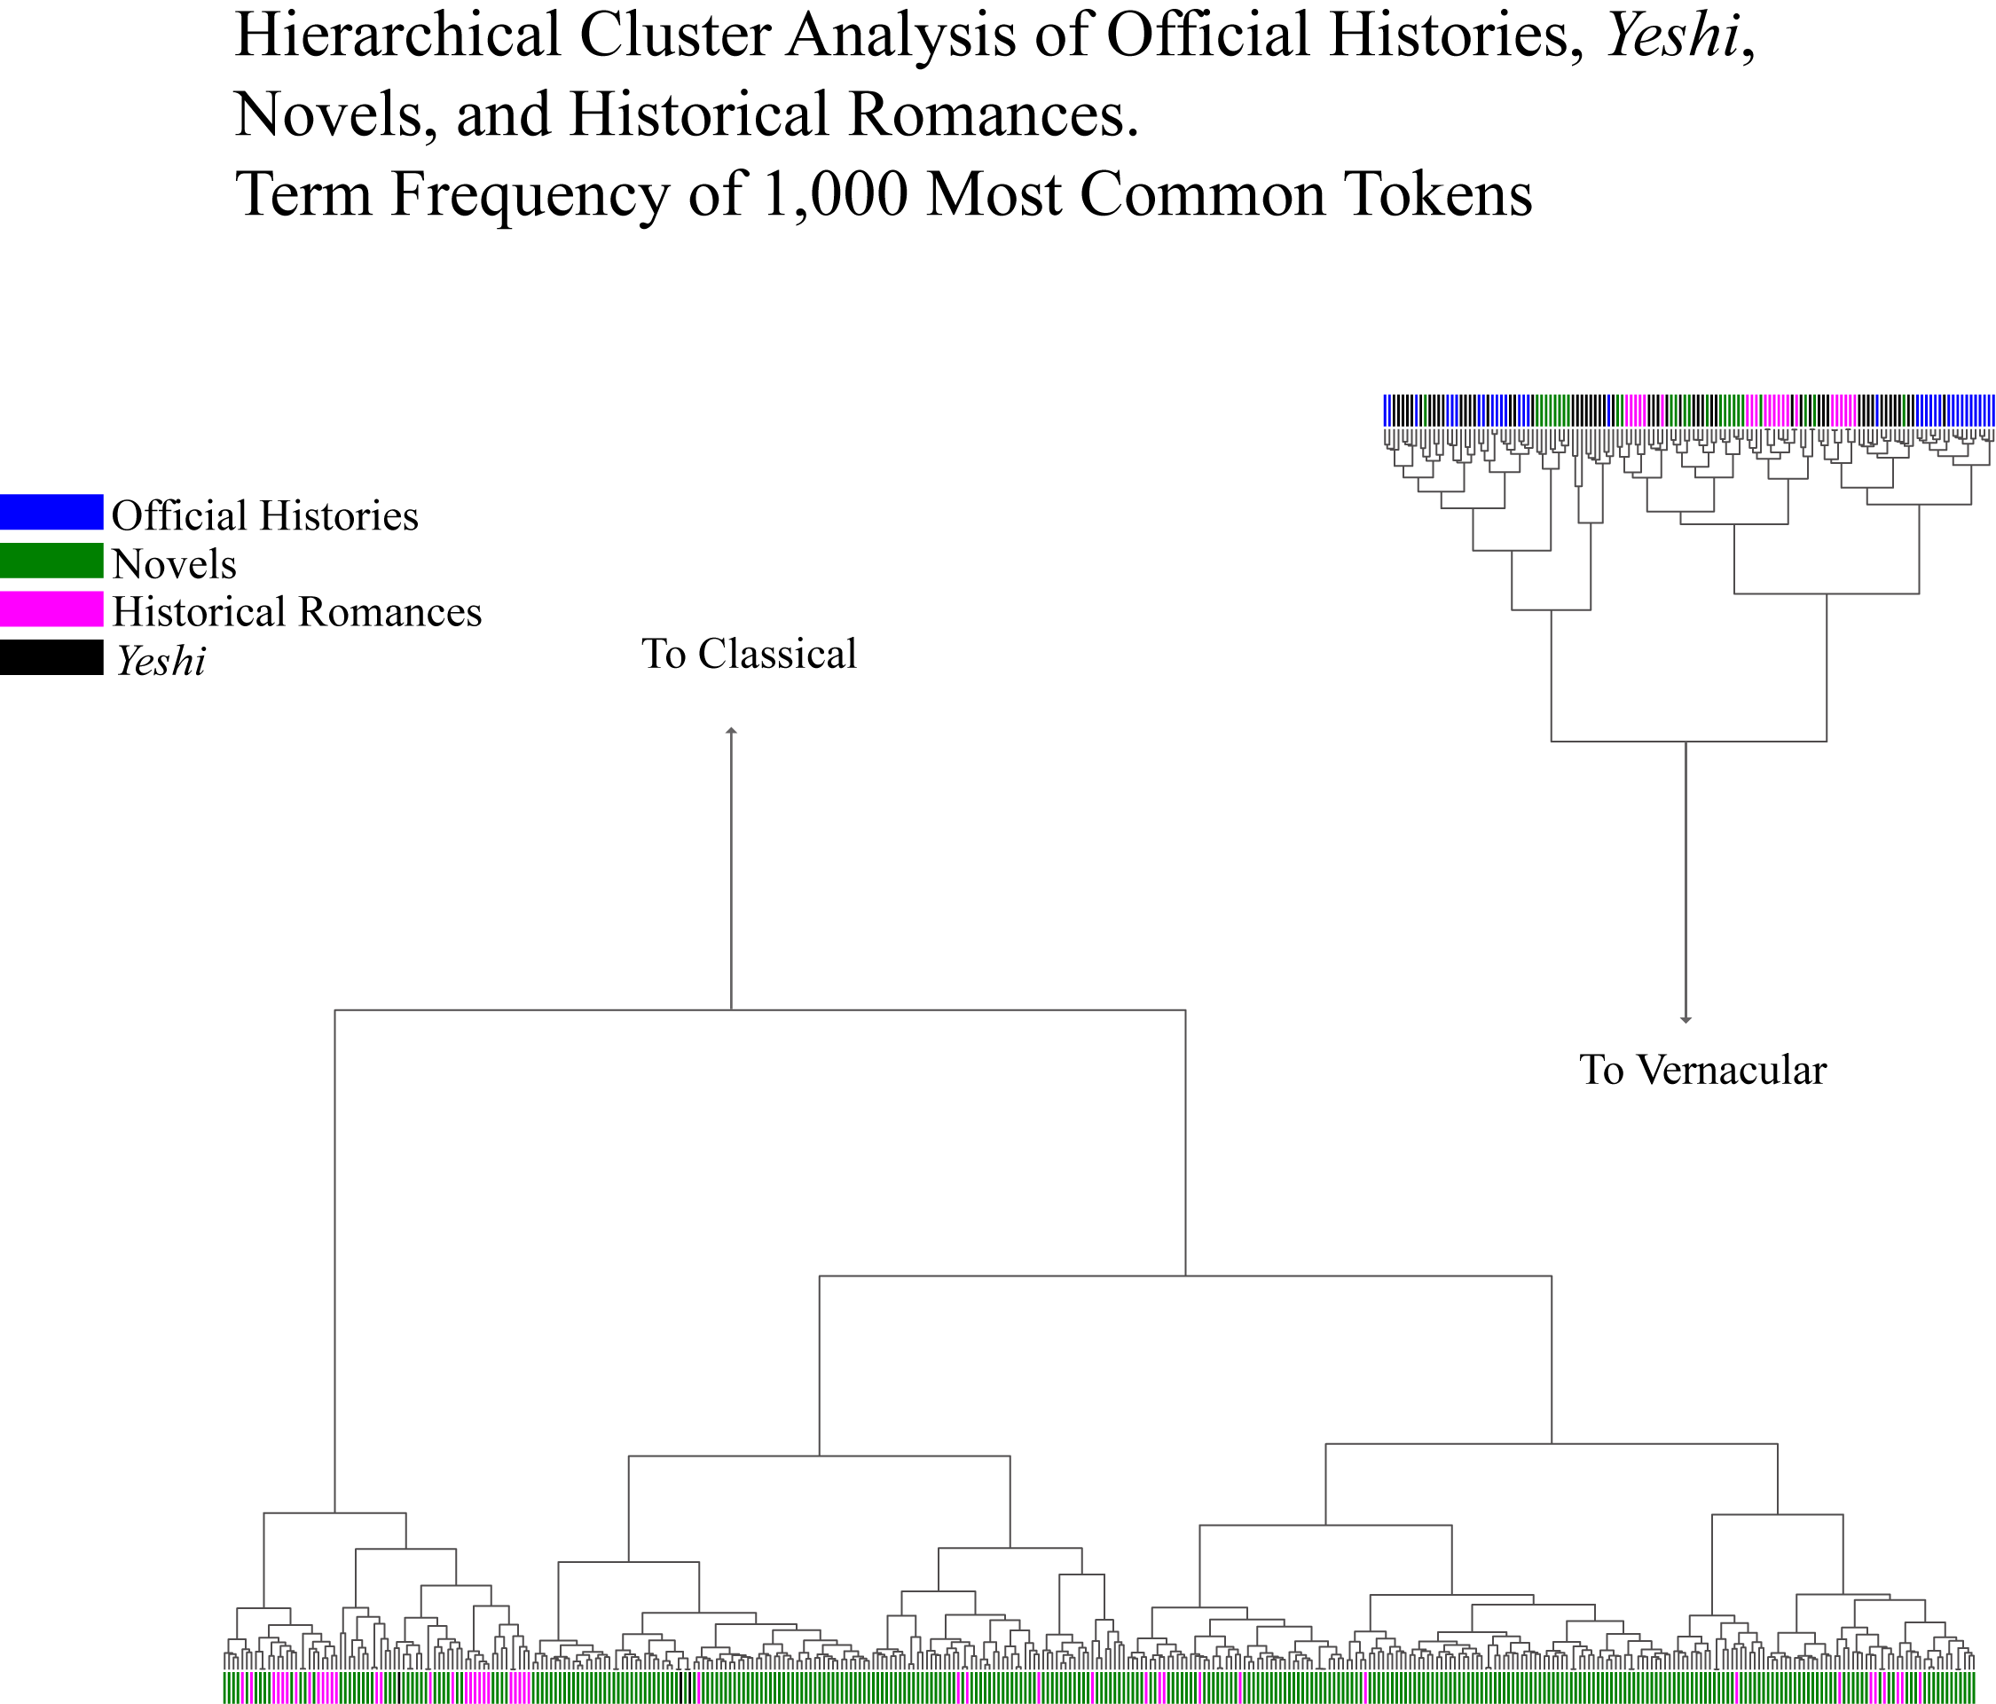

Slide 3
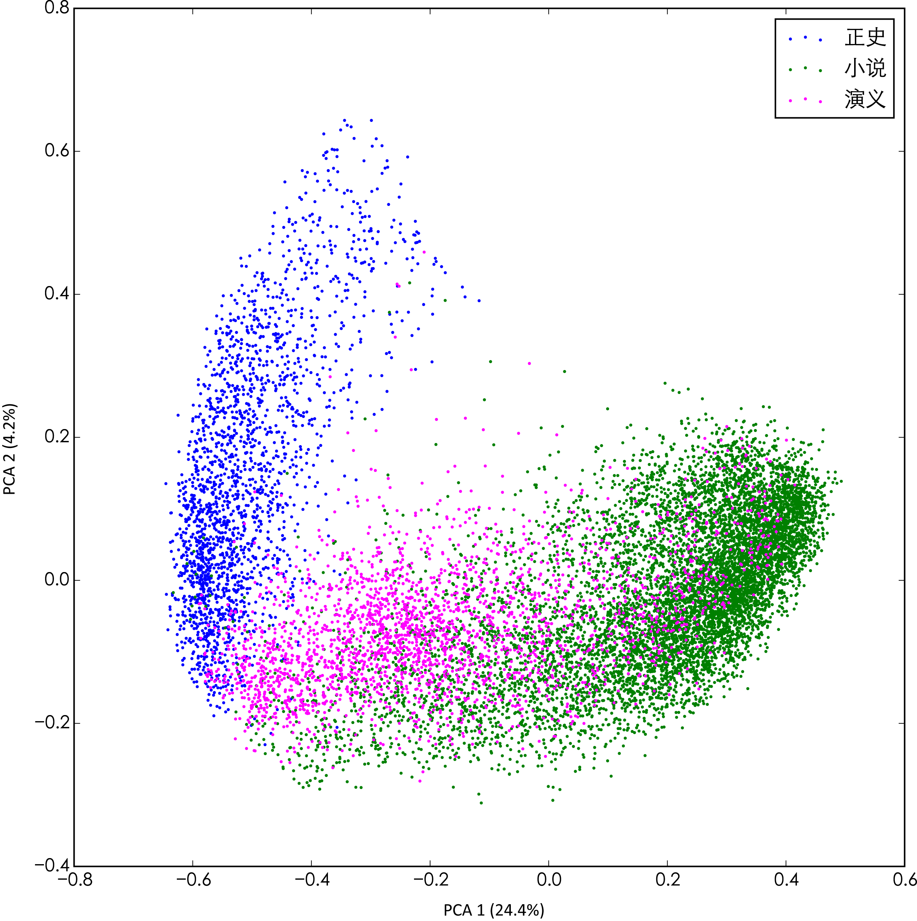
PCA
Official Histories, Xiaoshuo, and
Historical Romances
1,000 Most Frequent 1-grams
Internal Divisions
(卷／回)
32 Official Histories, 368 novels, 69 Historical Romances
Notes:
7

Slide 4
Necessary Software
www.continuum.io/downloads

Slide 5
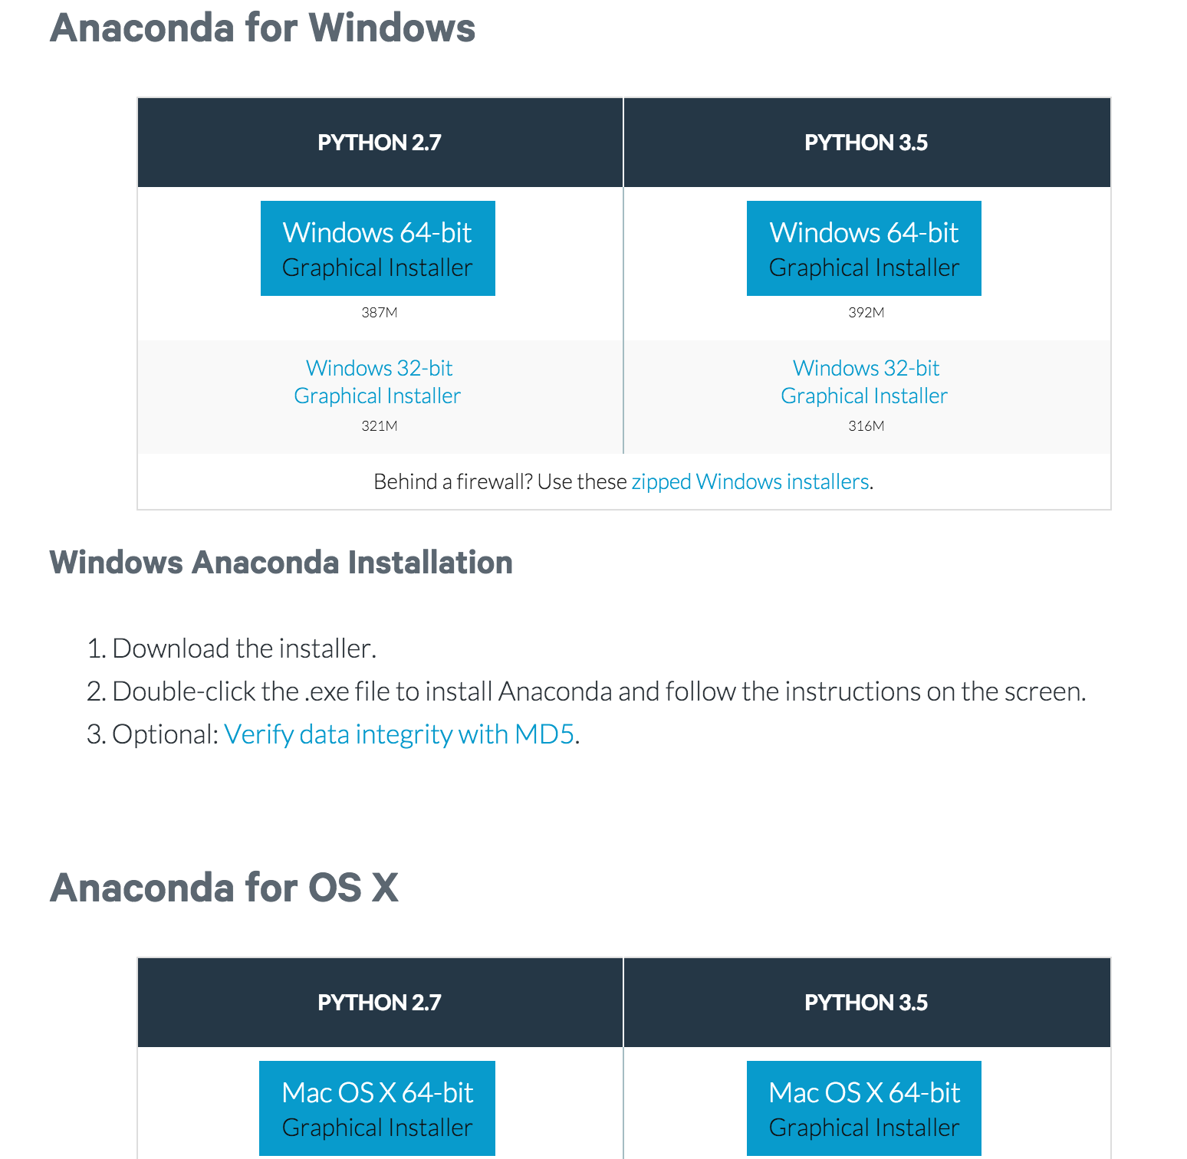

Slide 6
Necessary Materials
Stanford DH Asia Stylometry.ipynb
Stanford DH Asia Python Basics.ipynb
test.txt
metadata.txt
corpus (folder that contains sample texts)

Slide 7
corpus
Contains 14 documents
Named 00.txt, 01.txt, etc.

Slide 8
metadata.txt
Contains information describing corpus documents
In the format
Document ID, Title, Author, Era, Genre
e.g.
00 紫钗记 汤显祖 明 传奇

Slide 9
test.txt
Plain text file. Just there to show how to open file.

Slide 10
Download all the files
Put them all in the same folder
DHAsiaWorkshopVierthaler
metadata.txt
test.txt
Stanford DH Asia Stylomtery.ipynb
Stanford DH Asia Python Basics.ipynb
corpus
00.txt
01.txt
...

Slide 11
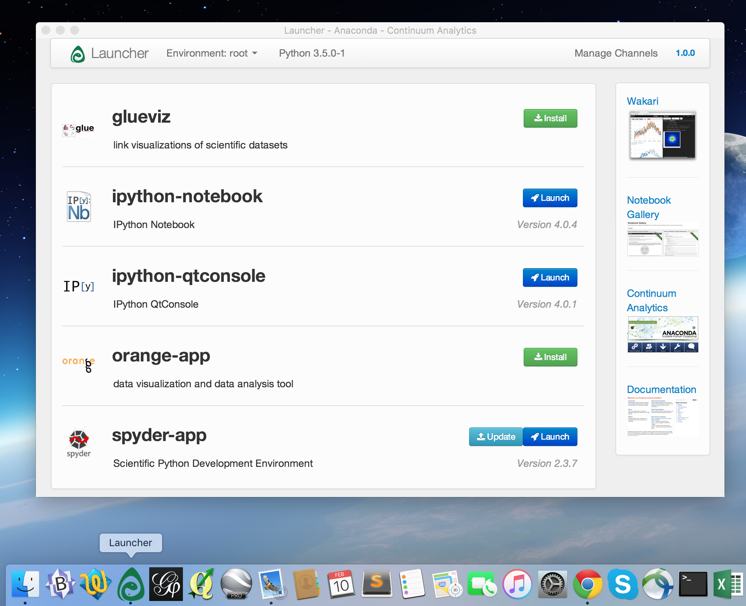
Open Anaconda Launcher

Slide 12
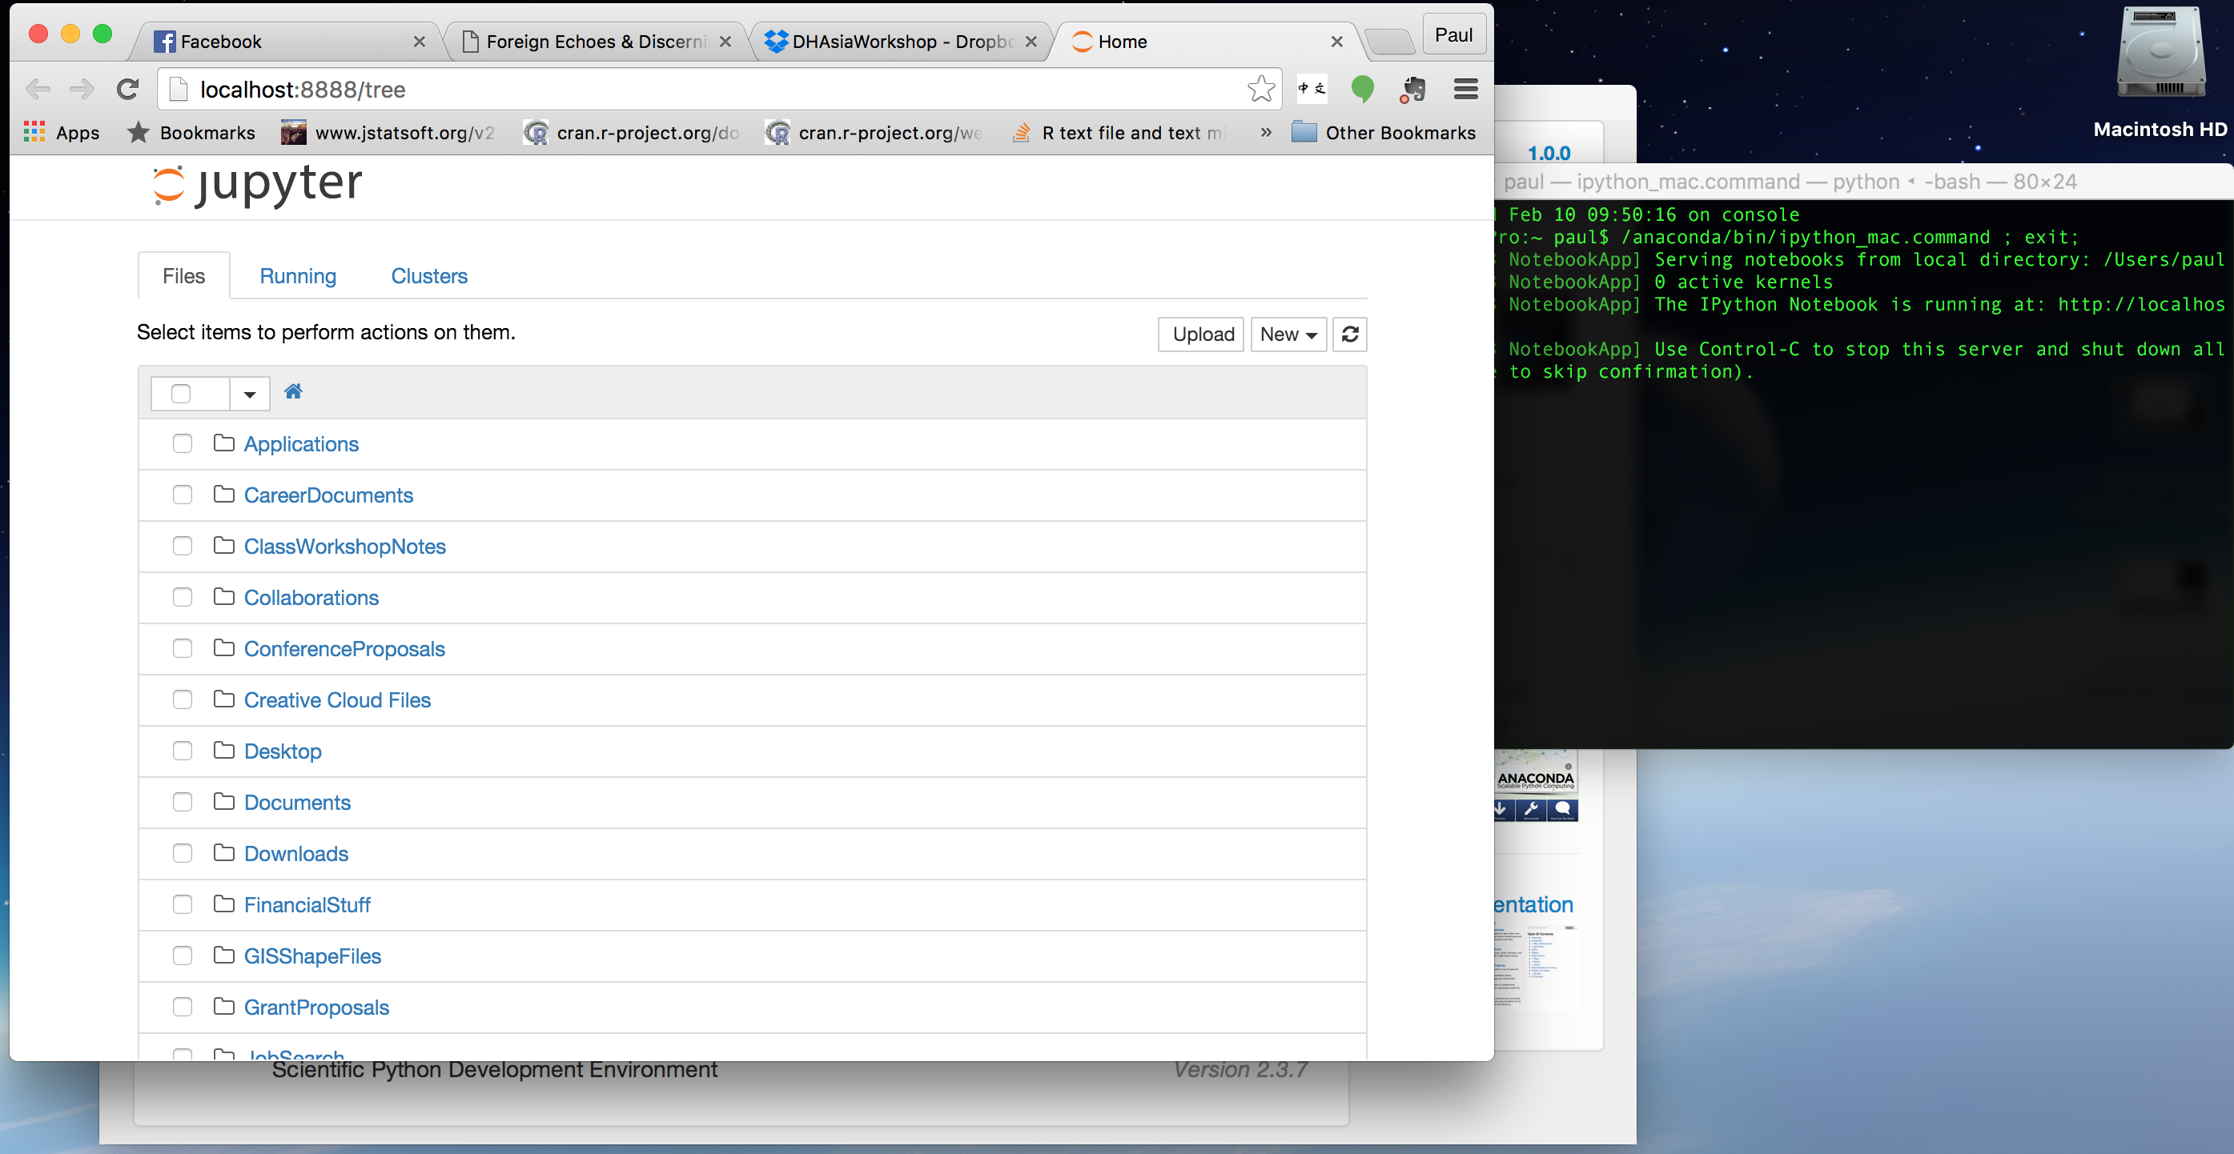

Slide 13
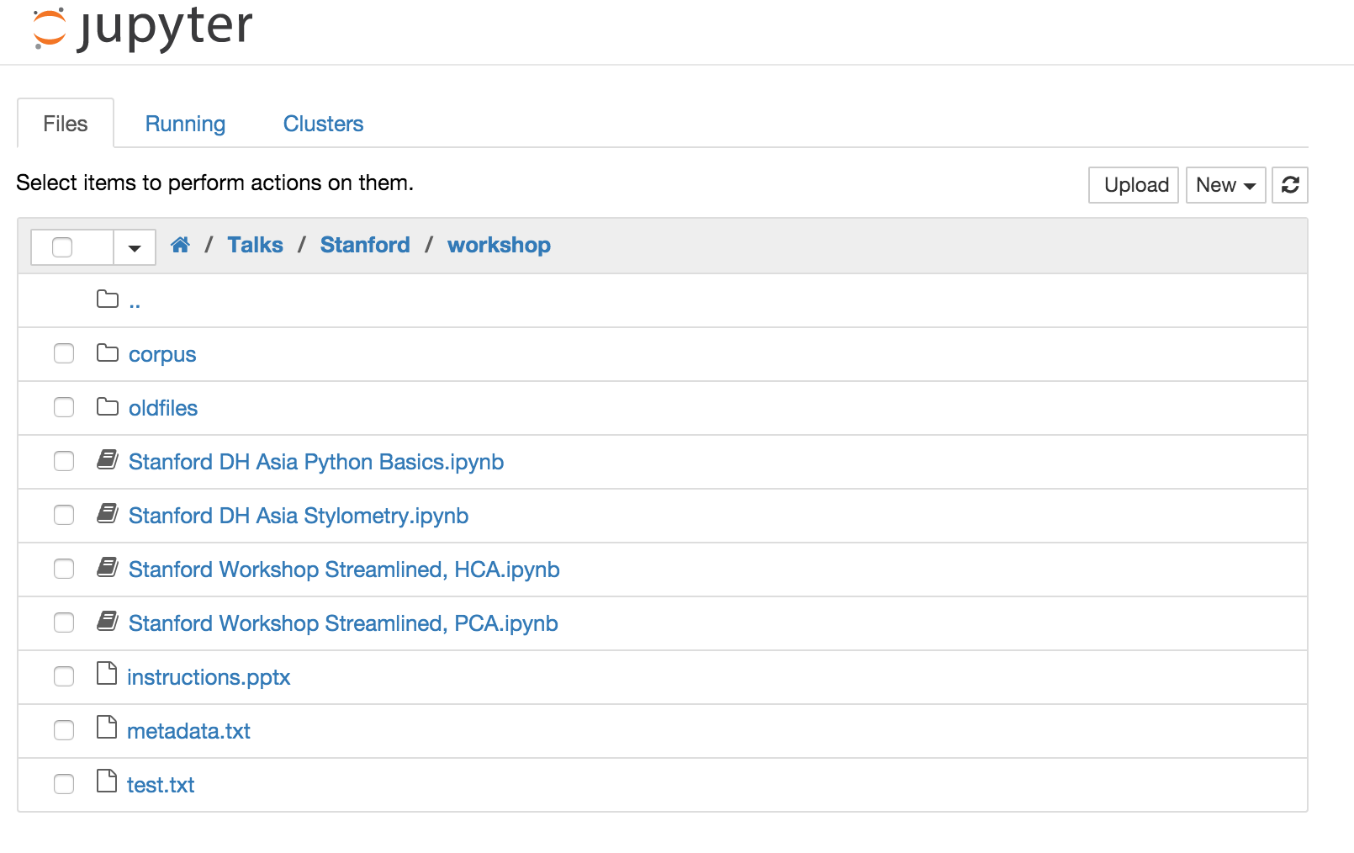

Slide 14
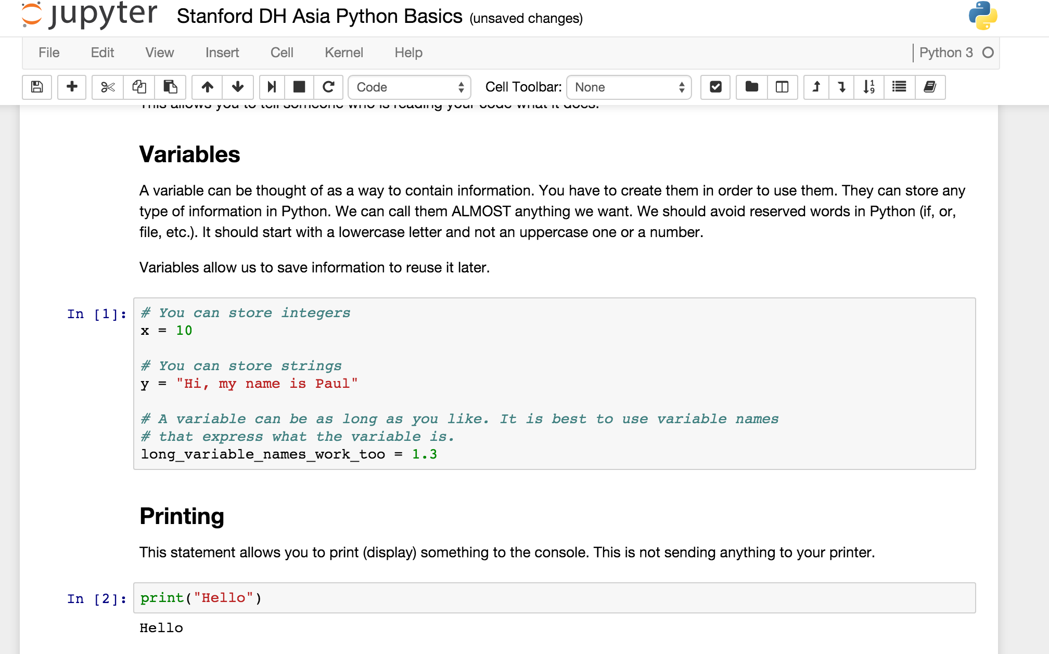

Slide 15
As we go through the workshop you will have to run each code box.

Slide 16
In the Stylometry notebook If you run a cell in the middle without running the prior cells it may not work

